Slide 1


Seoul Bike Sharing Demand Prediction
Using Linear Regression
Project Supervisor : Dr.A.C.Shantha sheela, M.E.,Ph.D.
Name of the Student : Sravya Namburu
Register Number : 39110962

Slide 2
Presentation Outline
Course Certificate
Introduction
Objectives
Scope
Ideation Map / System Architecture
Algorithms and Methods
System Implementation
Results
Conclusion
References

Slide 3

Course Certificate

Slide 4
Introduction
Bike system provides user to rent a bike from one docking station, where user can ride and then return in another docking station.
Ddareungi is a bike sharing system in South Korea, which started in the year 2015, known as Seoul bike in English.
Han River is the initial place where Ddareungi was first started in Seoul.
It was started to overcome issues like greater oil prices, congestion in traffic and pollution in the environment and to develop a healthy environment for citizen of Seoul to live.

Slide 5
Problem statement
Docking stations are computerized stands for the purpose of pickup and drop off of the rental bikes.
Seoul bike users can verify their trip details (distance, duration) and measure of bodily activities (burnt calories).
With this kind of smart technology and convenience, the use of Rental bike is increasing every day.
So, there is a need to analyze and manage the bike rental demand and manage the continuous and convenient service for the users.

Slide 6
Objectives
The main objective of this project is to provide the required information to analyze and predict the Seoul bike usage by people using linear regression.
Through this project, we can get the insight about the usage of bike system in Seoul and the variation of data based on the weather conditions etc.
Analyzing the data which includes weather information like Temperature, Humidity, Windspeed, Visibility, Dewpoint, Solar radiation, Snowfall, Rainfall, seasons, the number of bikes rented with hours and date and day information.

Slide 7
Scope of the Project
We are required to model the demand for rented bikes with the available independent variables.
The management can accordingly manipulate the business strategy to meet the demand levels and meet the customer’ s expectations.
Further, the model will be good way for management to understand the demand dynamics of a new market

Slide 8
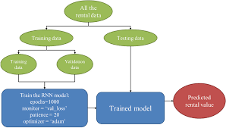
IDEATION MAP

Slide 9
Algorithms and Methods
This experiment is carrying out machine learning algorithm multiple linear regression.
Taking y(dependent variable) as Rented Bike Count column and x(independent variables) as rest of all columns in the given dataset . If x has categorical variables convert into integers. We will train and testing the model and evaluting the model.
The performance evaluation indices used here are: Root Mean Squared Error(RMSE), Mean Squared Error(MSE), Mean absolute Error(MAE), Co-efficient of determination(R2 score). .
Since python is simple,efficient,interpreted,object oriented,compatible, it is used for doing the project based on basic syntax.

Slide 10
System Implementation
Firstly we need to install Python in our system and set it up.
Once done, we select our best algorithm(i.e., Multiple linear regression), proceeding to experiment with fine-tuning our model to improve prediction accuracy.
In the algorithm screening phase, we used all available independent variables as features.
After going through the dataset, convert the data-time attribute in proper format and we separate day, month, year, and hour into separate columns so that it is easy to perform operations on the data.
Divide temperature, humidity and wind speed variables into categories. Doing so we can get better accuracy in the model.

Slide 11
HARDWARE AND SOFTWARE REQURIMENTS
programming language : Python 3.7.0 and above versions
hardware requirements : CPU
software requirements : Microsoft Windows10
As we need to connect to internet for opening websites and gather information about the skills required for the jobs, we can also use other programming languages like C, C++, Java but its effective to use and also have predefined functions to use in the python language since the syntax for this programming language is simple to use and is more effective comparatively.
So we have used python for this project for accessing sites and recommended skills as per the present trending technologies

Slide 12
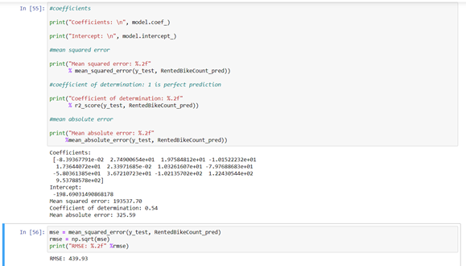
Results And Discussion
On executing the python code of predicting rented bike count ,we get the output as :
MSE = 193537.70
MAE = 325.59
RMSE = 439.93
Co-efficient of determination = 0.54

Slide 13
Conclusion
Bike renting systems can be the new boom in India, with use of various prediction models the ease of the operations will be increased.
The result show that multiple linear regression algorithm improve the R2 ,RMSE, MSE, MAE.
This shows that multiple linear regression algorithm in machine learning models can be used in effective tool for rented bike count prediction

Slide 14
References
Barnes, G., & Krizek, K. (2005). Estimating bicycling demand. Transportation Research Record, 1939(1), 45– 51.
Breiman, L. (2017). Classification and regression trees. Routledge, Taylor and Francis, FL.
Corcoran, J., Li, T., Rohde, D., Charles-Edwards, E., & Mateo-Babiano, D. (2014). Spatio-temporal patterns of a public bicycle sharing program: The effect of weather and calendar events. Journal of Transport Geography, 41, 292– 305.
El-Assi, W., Mahmoud, M.S., & Habib, K.N. (2017). Effects of built environment and weather on bike sharing demand: A station level analysis of commercial bike sharing in Toronto. Transportation, 44(3), 589–613.

